Slide 1


Six Degrees
PhilipP SHCHetinin, Kalen Hazlett, Morgan Quackenbush

Slide 2
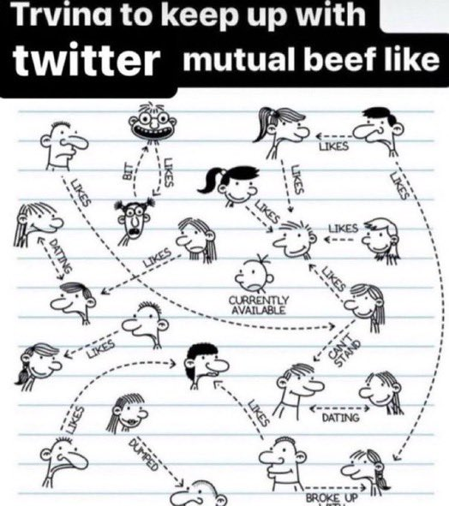
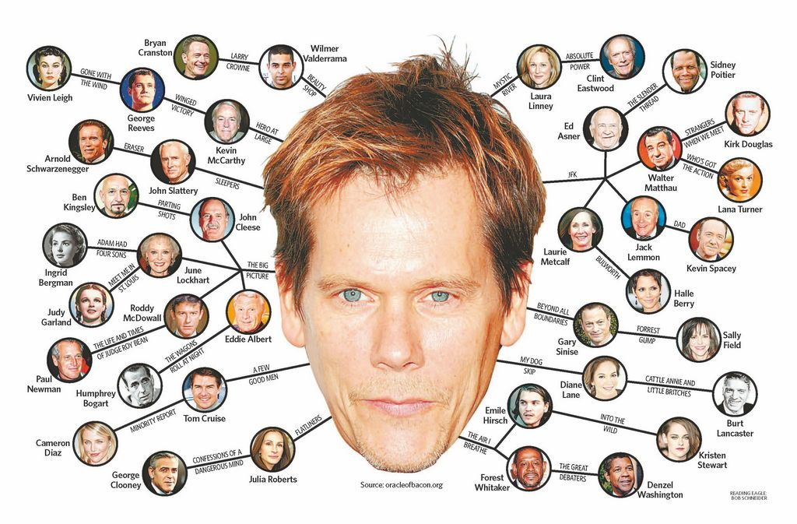
Objective
Create a program that finds minimum separation between users based on mutual connection
"Mutual" defined as someone a user follows and is followed by.
Visualize the graph of users with their connections

Slide 3

Project Flow
Rust prompts the user to enter in two usernames
Rust then sends a username to the mutuals checker via command line.
Python parses database file and returns intersection of followers and following
Process repeats until graph is mapped out, then BFS finds the shortest path.
Data is sent to the visualizer, which plots the formed graph.

Slide 4

Two Languages?
Originally Going to Web Scrape
Twitter API
Good Data Science Libraries in Python
Rust is emerging in critical systems and is compiled --> faster
Has 'memory safety'
Twitter API is expensive, and we are broke, so we created our own database

Slide 5
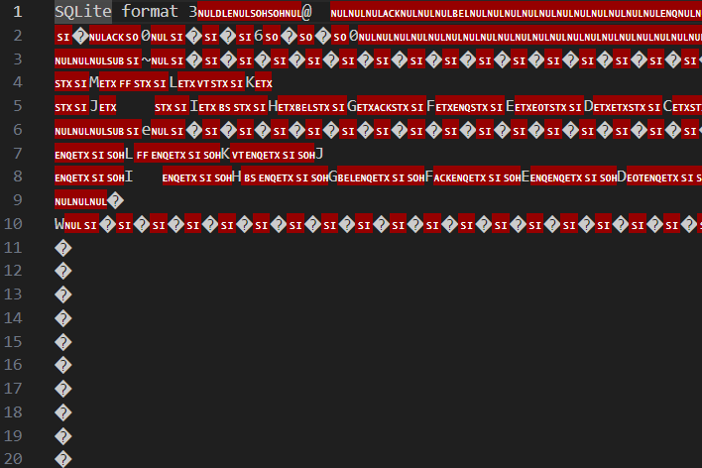
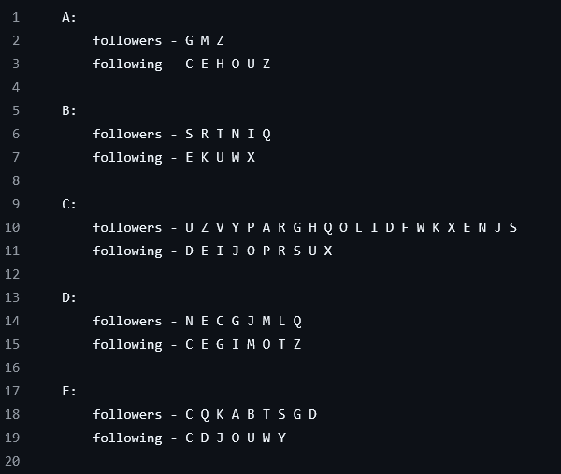
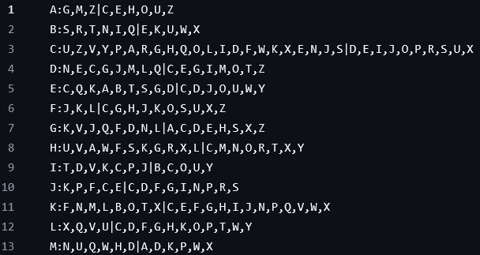

Database
Collection of tables (followers and following) that can search itself
Contains an index that organizes the tables into B-Trees, making searching much faster (O(log n))
Without the index, it would be no different than a line-by-line search O(n)

Slide 6
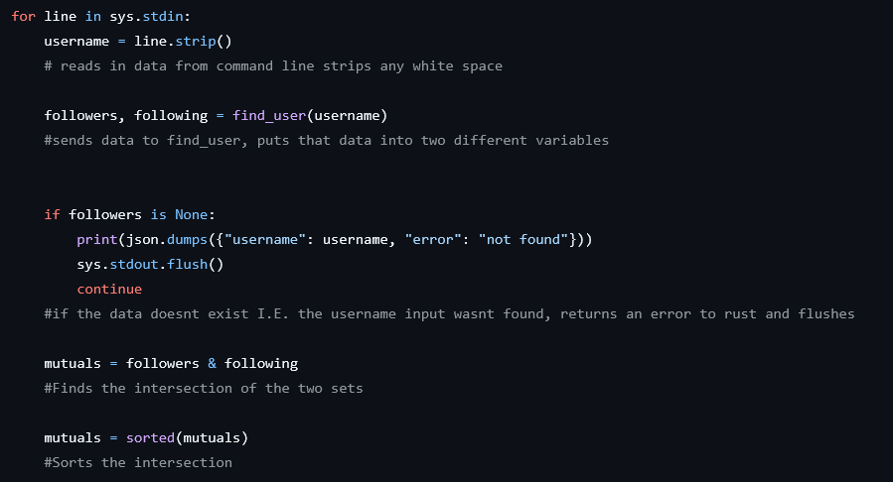
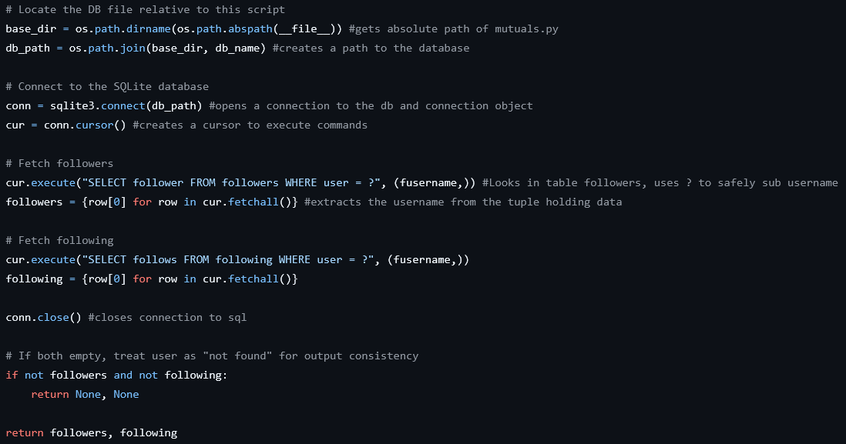

Mutual Sort
Receives an account that needs its mutuals found.
Runs an SQL Query that looks in the followers table and following table and collects the rows relevant to the user.
Extracts the data (the users followers and who the user is following) and puts that extracted data into sets.
Finds the intersection of the two sets and sends it back through command line

Slide 7

Rust
Main data structure of the project
Has the graph represented as an adjacency list
Computes BFS traversal to find shortest/only path
Trends towards O(V+E) where V is the number of Vertices and E is the number of Edges
Did not use Dijktra's because the weight was not important

Slide 8
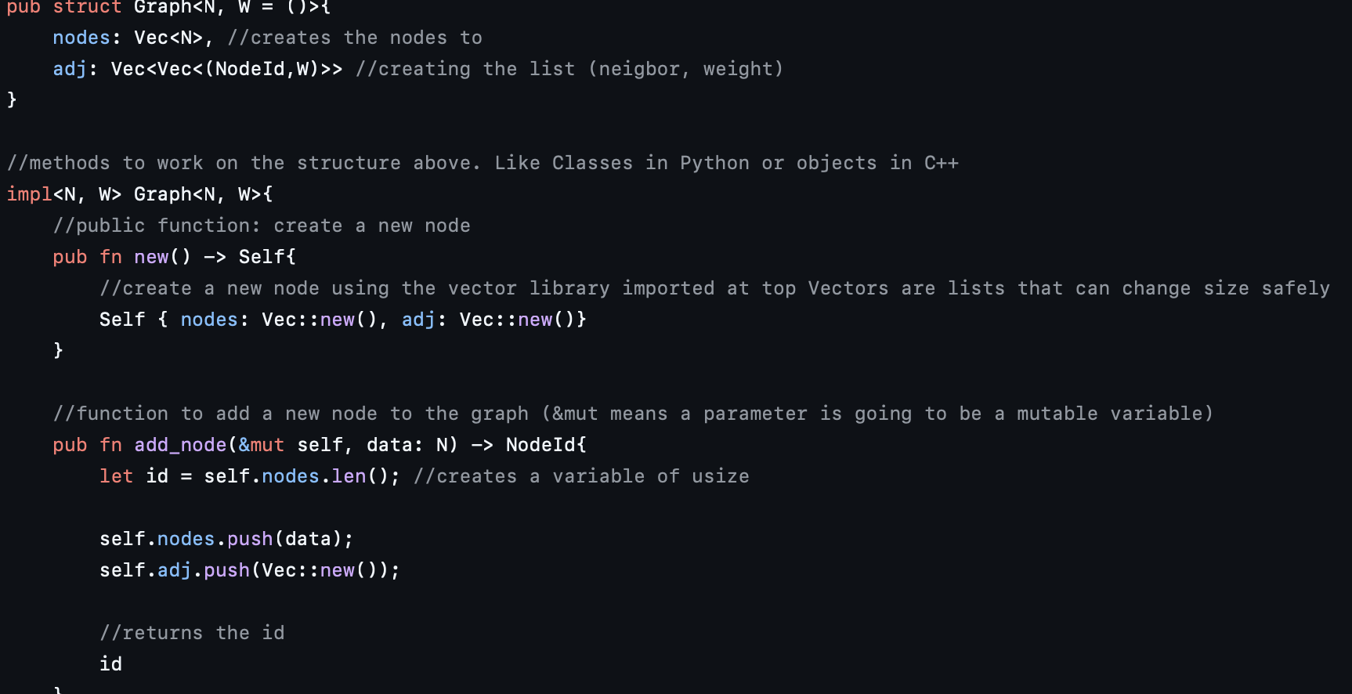
Graph

Slide 9
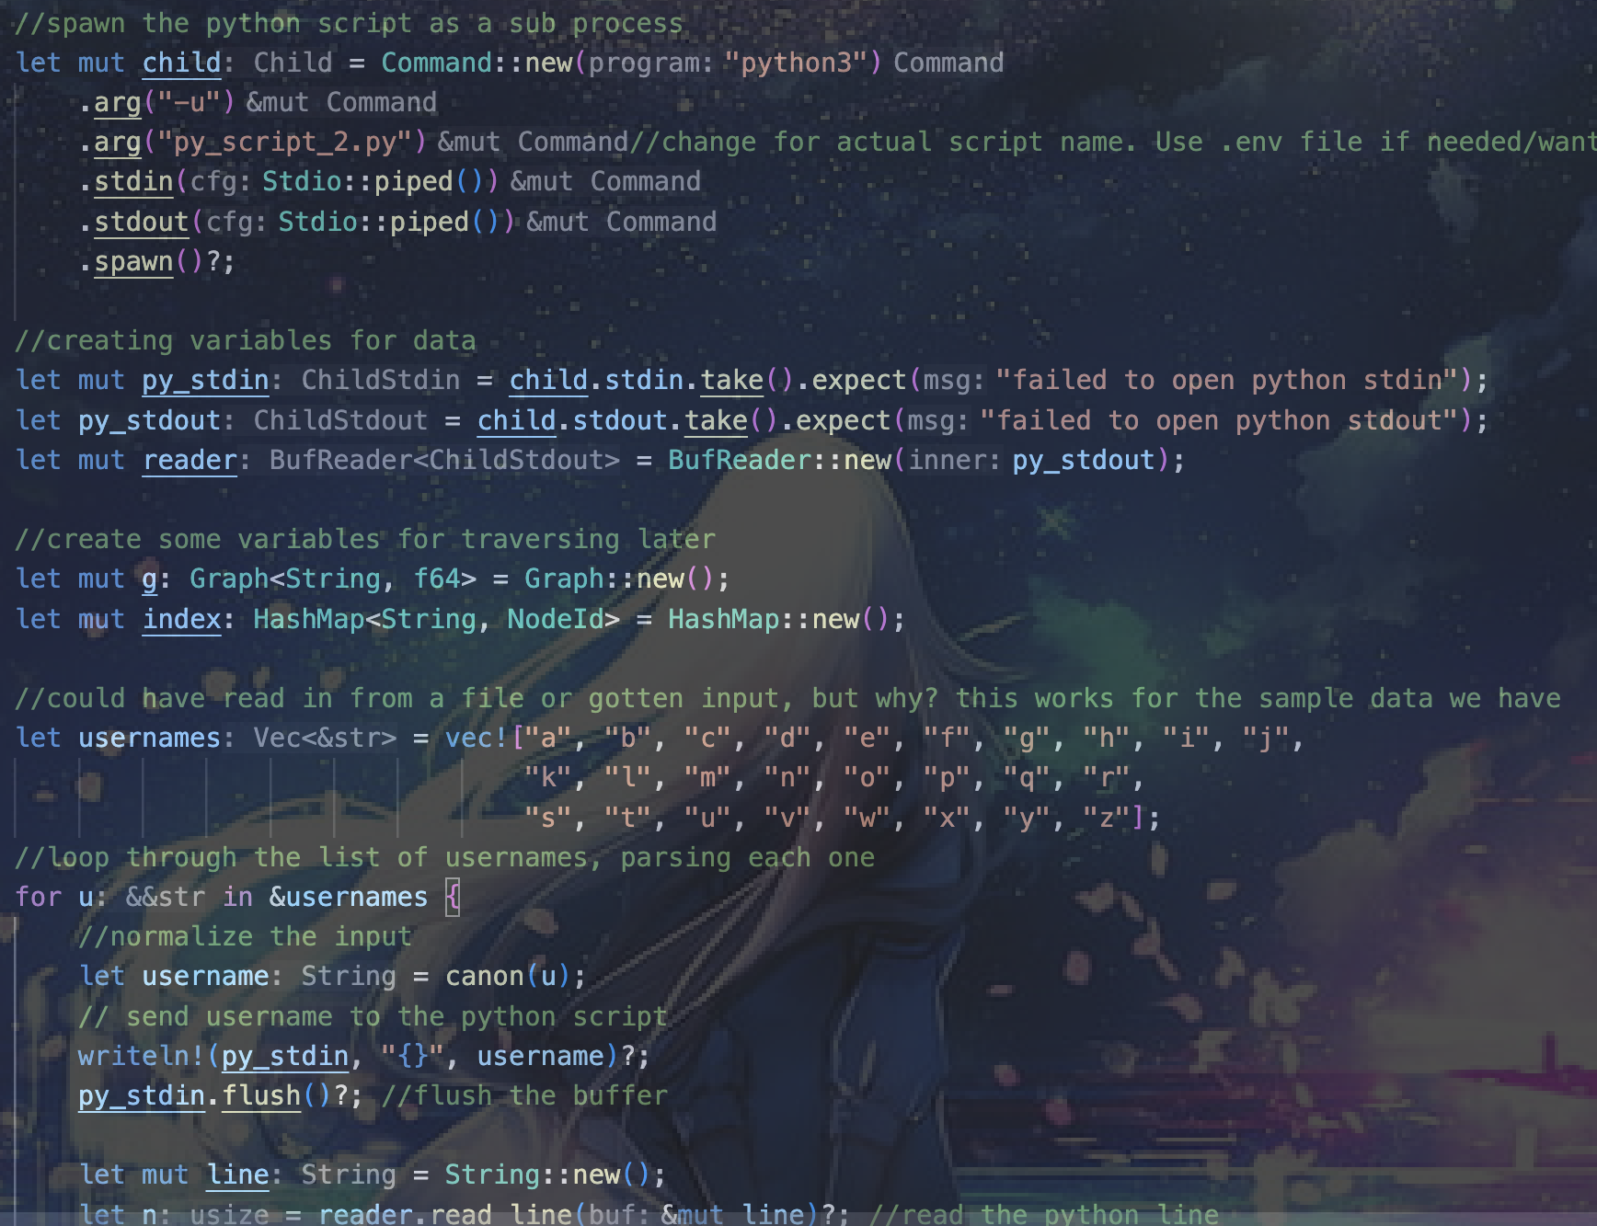
Communication

Slide 10
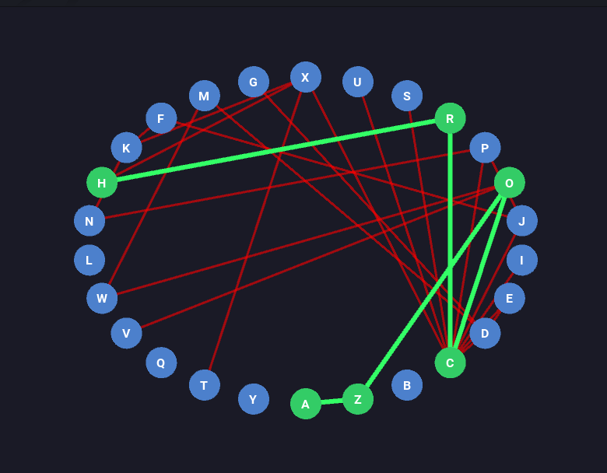
Visualization
Receives data from Rust code in json
Graph Information
Traversal Information
Plots Each user
Creates edges in between each user
Creates the path of traversal

Slide 11

Demonstration
It's a demo

Slide 12

Challenges
Conceptual Understanding of the Project
Using Two languages (Using Rust)
Finding/creating a data set that worked for our purposes
Debugging
Json parsing

Slide 13

Potential Enchantments
Live separation checker
Larger database
Use actual API (looking for sponsors)
Integrating Python into Rust using Py03

Slide 14
Resources and AI Statement
Multiple online articles:
https://www.geeksforgeeks.org/dsa/adjacency-matrix/
https://timclicks.dev/tip/how-to-create-a-2d-matrix-in-rust
https://www.geeksforgeeks.org/c/c-program-to-implement-adjacency-list/
https://medium.com/@kriangkrai.ratt/shortest-path-dijkstra-algorithm-with-rust-8fe1867d052a
https://www.w3schools.com/sql/sql_intro.asp
OpenAI ChatGPT model 5.0 for debugging and language translation
Claude AI

Slide 15

Questions?

